Slide 1
Science
Living Things and Their Habitats
Year One
Science | Year 2 | Living Things and Their Habitats | Local Habitats | Lesson 2

Slide 2
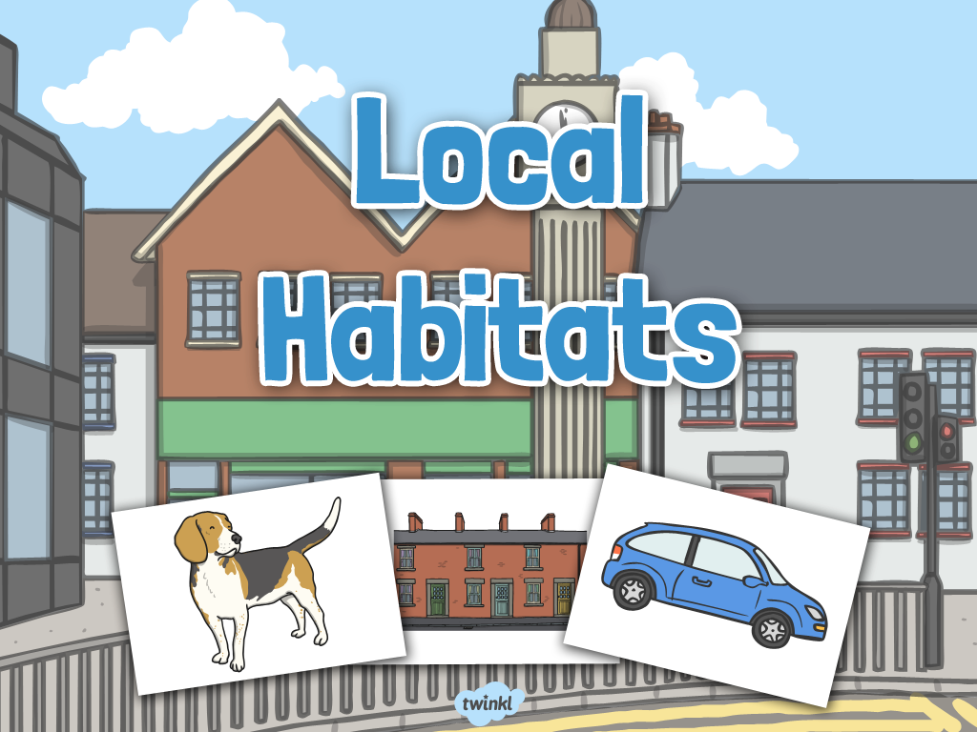

Slide 3
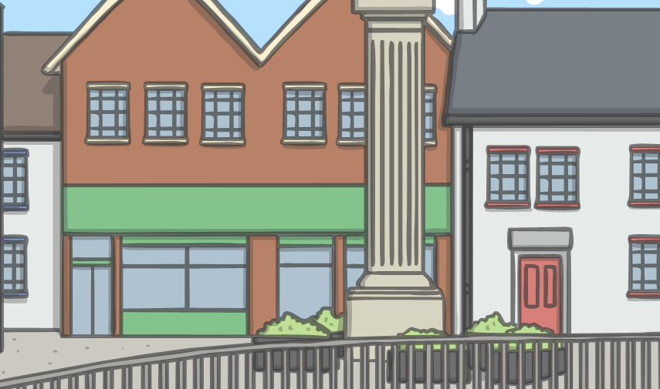
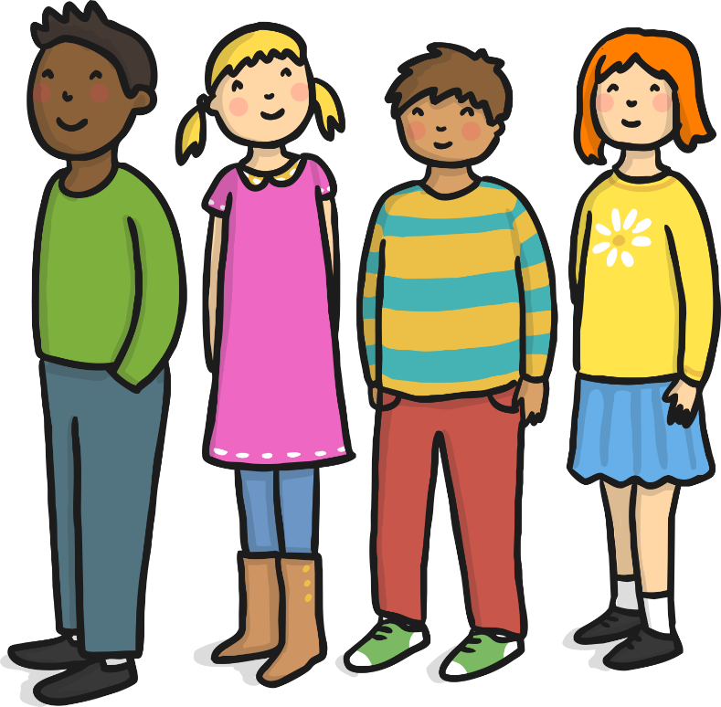
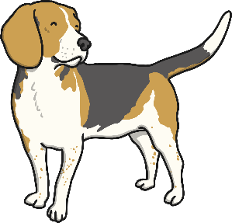
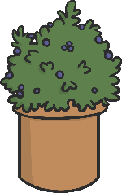
Our Habitat
You are alive!
Humans, all other animals and plants are all
living things.

Slide 4
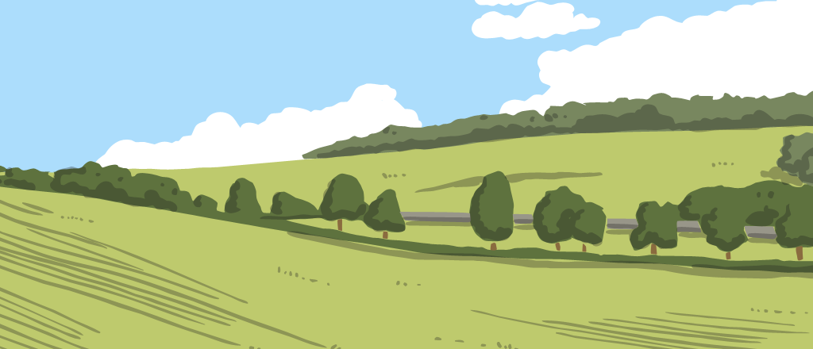
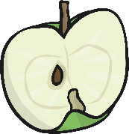
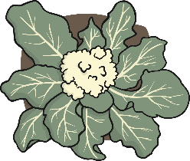
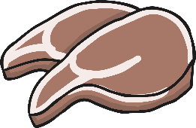
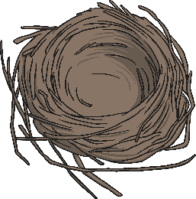
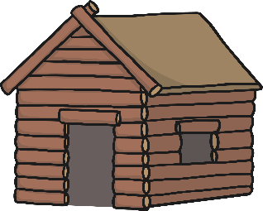
Our Habitat
To stay alive and healthy, you and all other living things need certain conditions that let them carry out the 7 life processes:
Food and water
Space to move, grow and have young
Air or oxygen
Shelter and safety

Slide 5
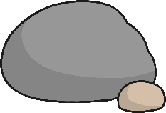
Our Habitat
A habitat is a place where animals and plants live, where they can find everything they need to stay alive.
A habitat can be as big as an ocean. . .
What is your habitat?
. . . or as small as a rock.

Slide 6
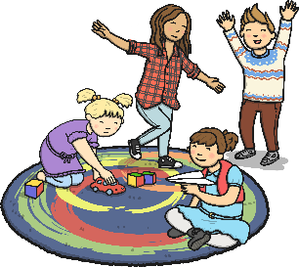
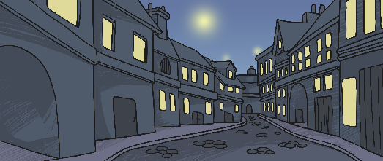
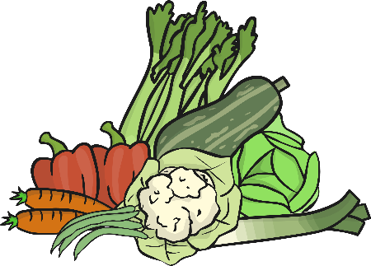
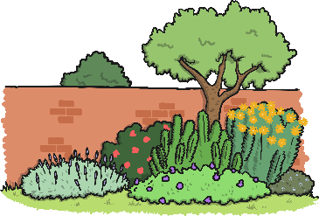
Our Habitat
Where do you live?
What living things live and grow there?
How does your habitat keep you safe and sheltered?
How does your habitat provide food and water?
How does your habitat provide space for you to move and grow?

Slide 7
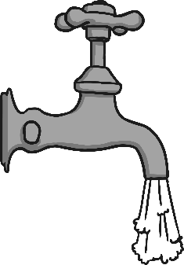
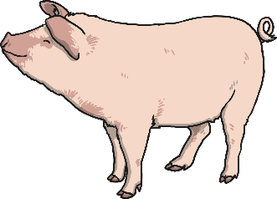
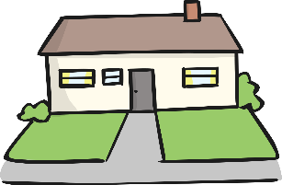
Our Habitat
Humans are unique because we can make big changes to our habitats to make sure we have everything we need. How do humans change their habitats?
We build roads and vehicles so we can travel everywhere we need safely and quickly.
We pipe fresh, clean water into our homes to use for drinking, cooking and washing.
We grow plants for food, and farm animals for meat and dairy products. We even have pets to keep us company!
We build houses with heating to protect us from cold weather, or with air conditioning to protect us from the heat.

Slide 8
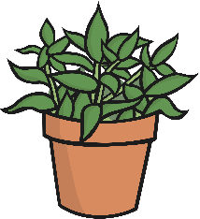
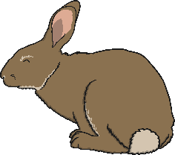
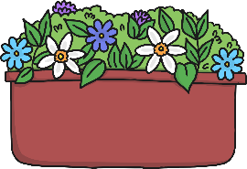
British Habitats
Plants and animals can’t make big changes to their habitats like humans can. They rely on the environment around them to provide them with everything they need.
This means they have to live somewhere that has the right conditions to help them stay alive and well.
Because different places have different conditions, the plants and animals that live there are different too.
We are going to look at some common British habitats.

Slide 9
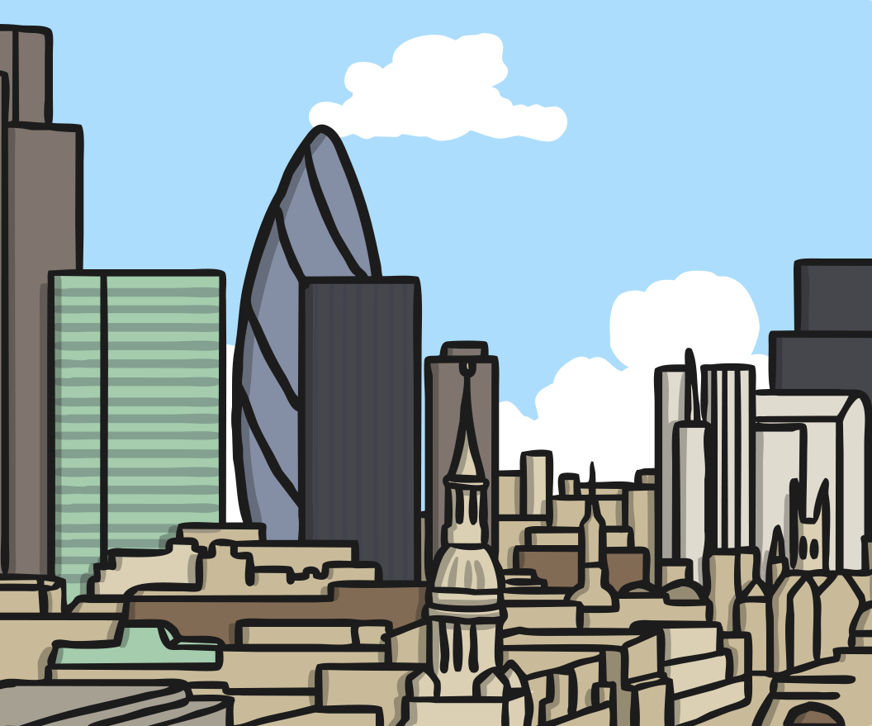
Urban Habitats
Most people in Britain live in an urban habitat. Urban habitats are areas with lots of buildings for people to live and work in.
Some of the living things in urban habitats are here because people have put them there. This includes trees, hedges and plants in parks and gardens, and our pets. There are also many living things that grow wild in urban habitats. These plants and animals have found ways to survive alongside all the people that live nearby.

Slide 10
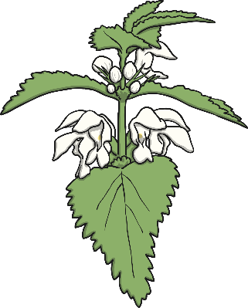
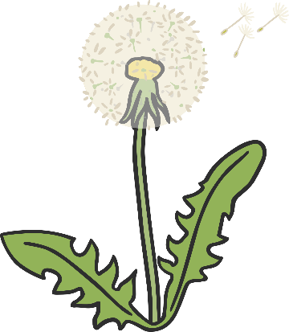
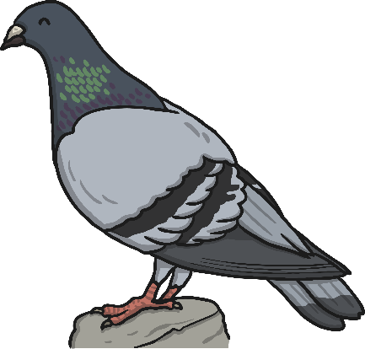
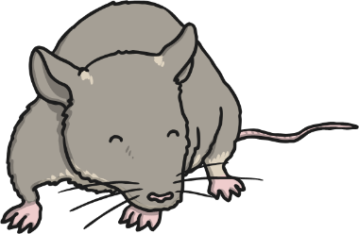
Urban Habitats
Flowering plants such as nettles, daisies, dandelions and buttercups grow in parks, gardens and hedges. They even grow in abandoned buildings and through cracks in concrete. Many insects, slugs and snails live among the plants.
Some animals, such as squirrels and garden birds, get their food from the trees and hedges that grow in cities. Other animals like foxes, pigeons and rats are able to live in cities because they get most of their food from the waste that people leave behind.

Slide 11
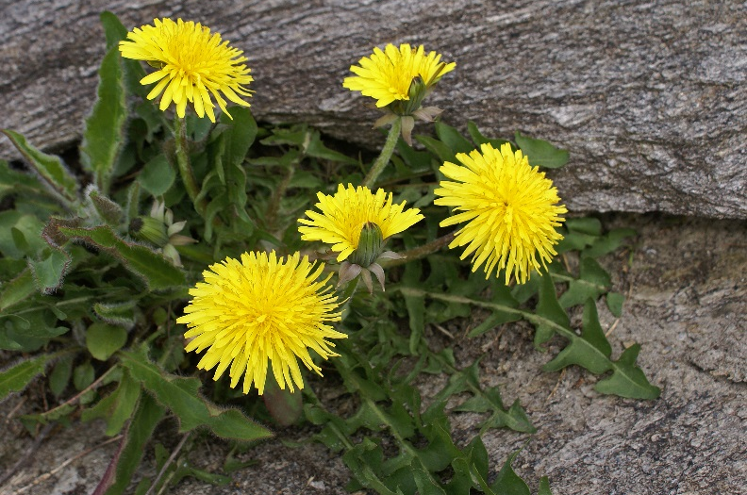
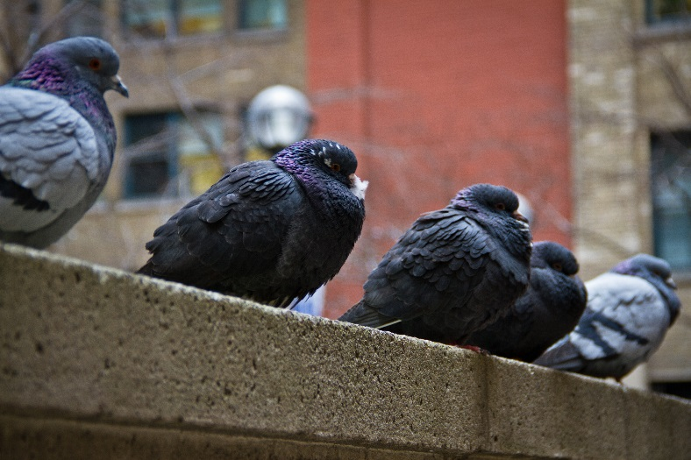
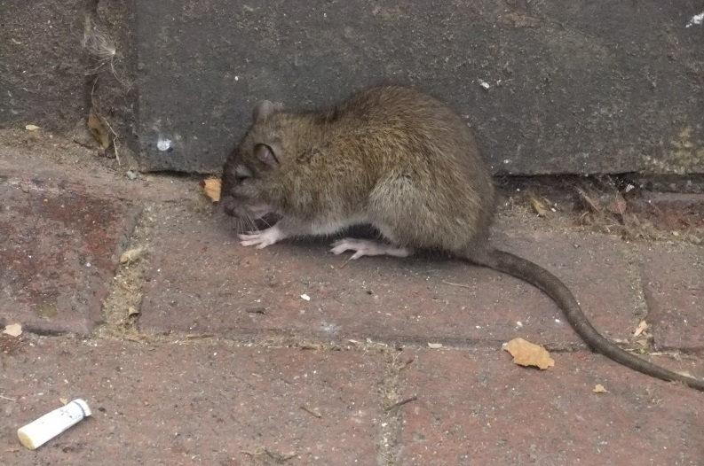
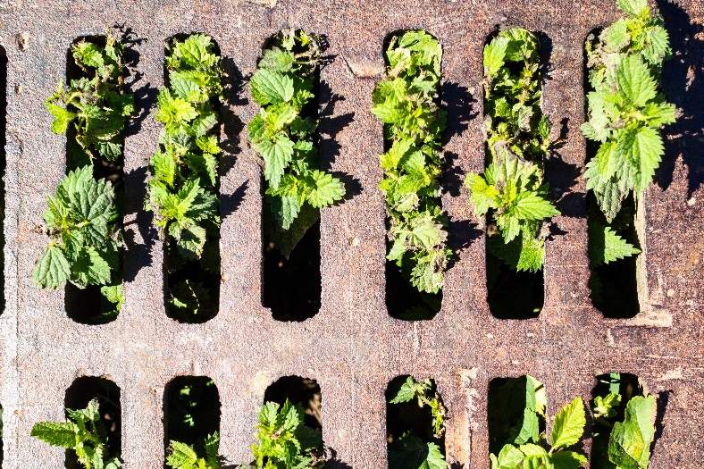
Photos courtesy of Randl Hausken, flowzim, oatsy40 and Johan Neven (@flickr.com) - granted under creative commons licence - attribution

Slide 12
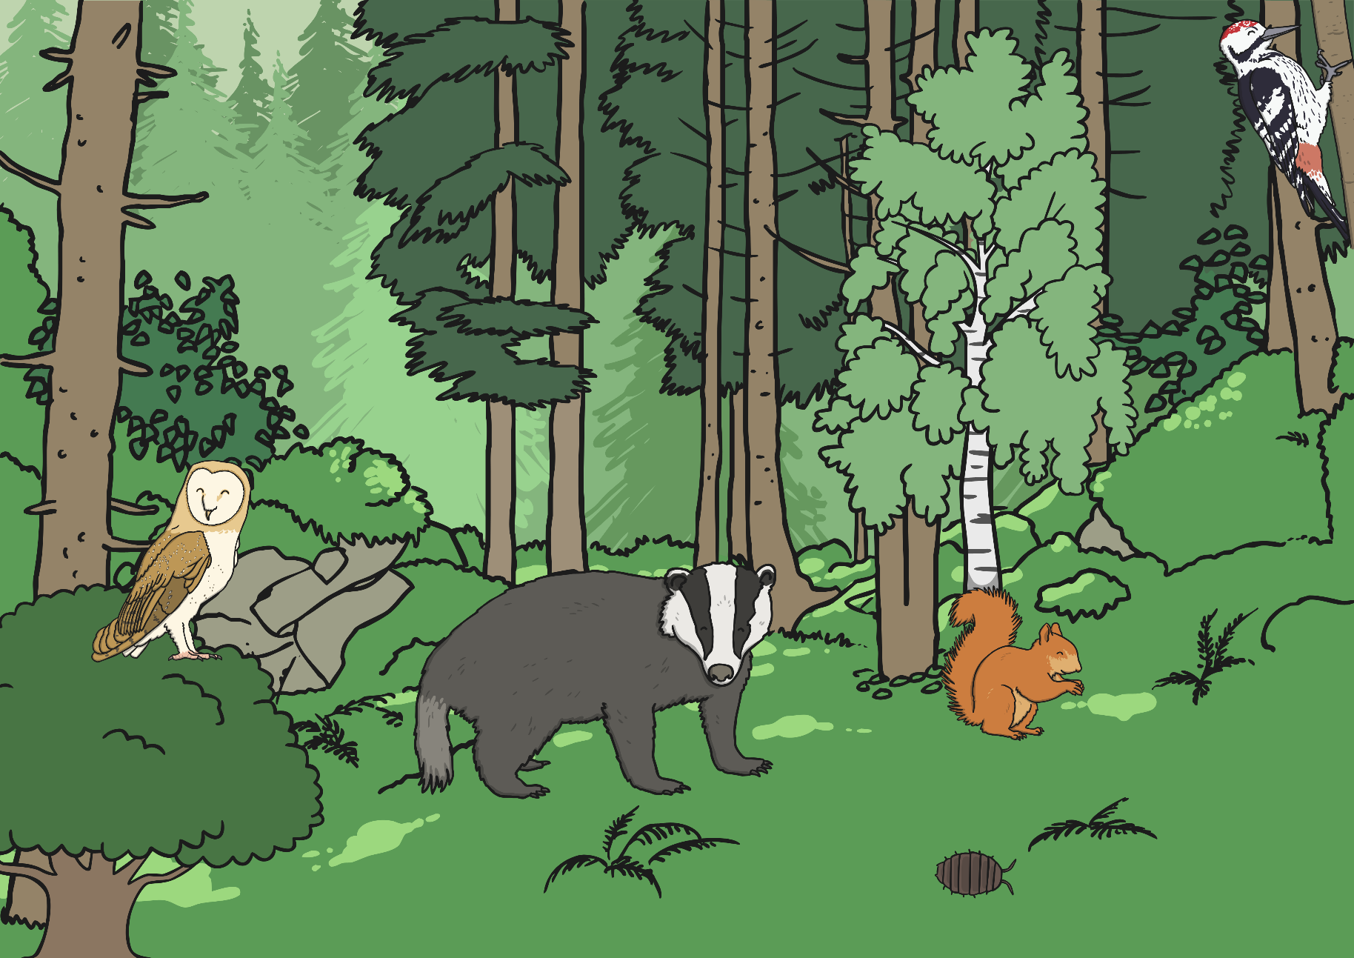
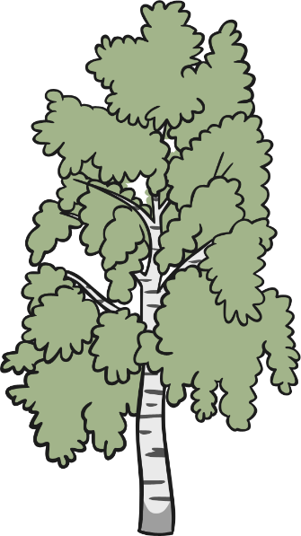
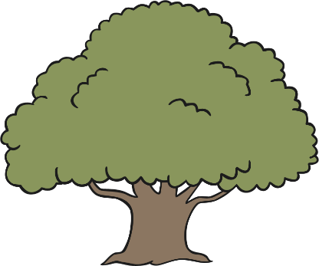
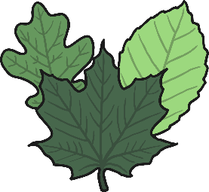
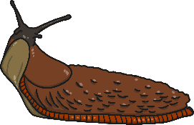
Woodland Habitats
In a woodland habitat there are lots of trees that grow close together. Common trees that grow here include English oak, ash, beech, hawthorn and birch.
Most British woodlands are deciduous, which means the leaves fall off the trees in winter. The fallen leaves provide food and shelter for many creatures and rot into the soil, making it rich and full of nutrients.
As well as the fallen leaves, there are shrubs, flowers and grasses beneath the trees. These provide a home for many insects and invertebrates like worms, slugs and snails.

Slide 13
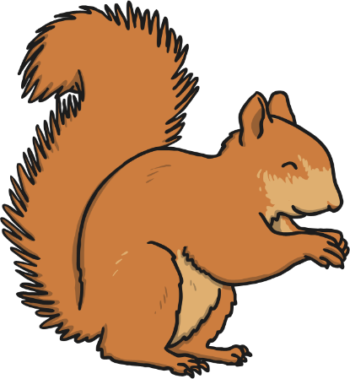
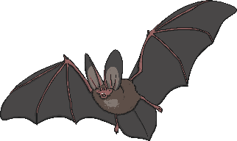
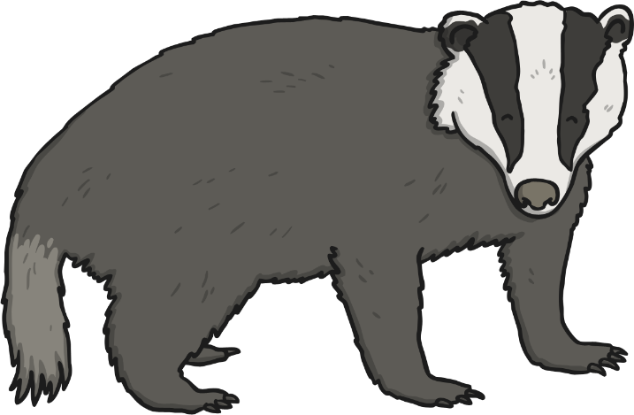
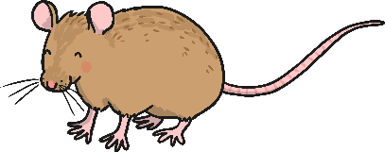
Woodland Habitats
The fruit and seeds of the trees, and the small creatures that live among the leaves, provide food for many birds and small mammals such as bats, mice, squirrels, stoats and weasels.
Bigger mammals such as badgers, foxes and deer are common in woodland. There are also beavers, otters, and wild boar, though these animals are less common.

Slide 14
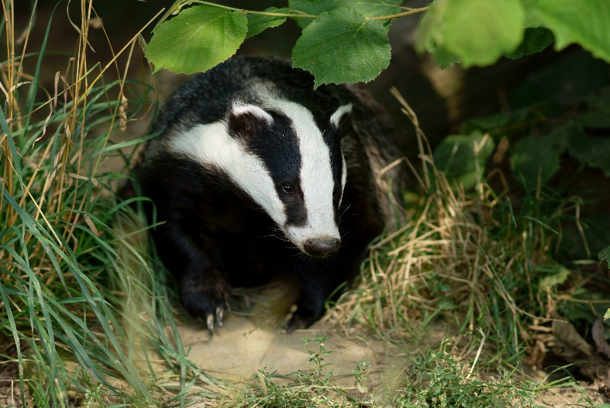
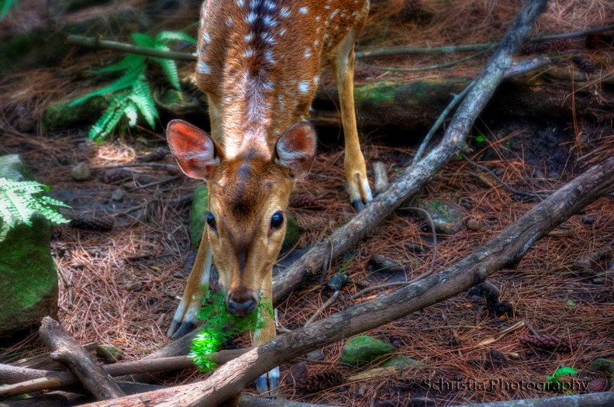
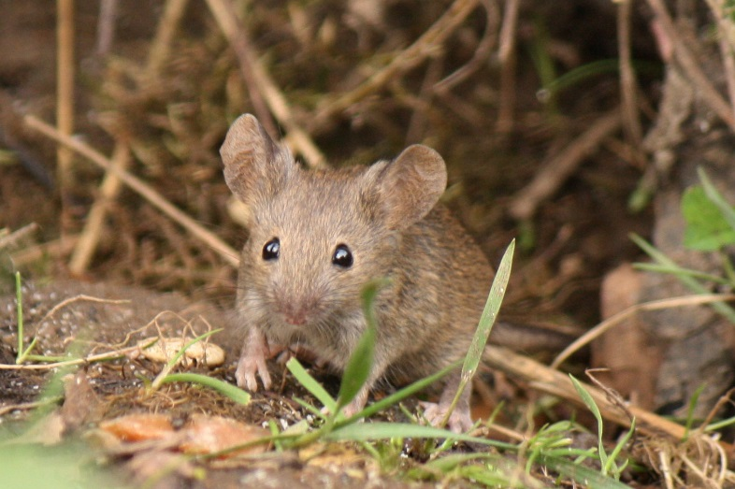
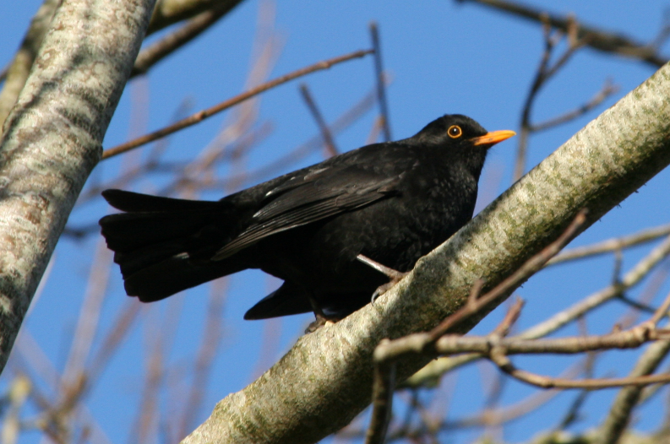
Photos courtesy of Peter Trimming, Schrista, Jans Canon and Simon Davies (@flickr.com) - granted under creative commons licence - attribution

Slide 15
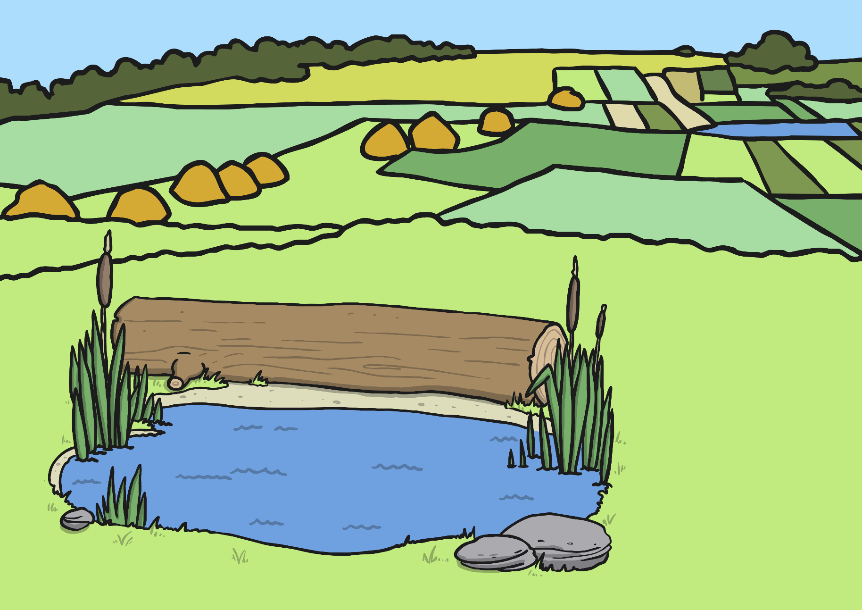
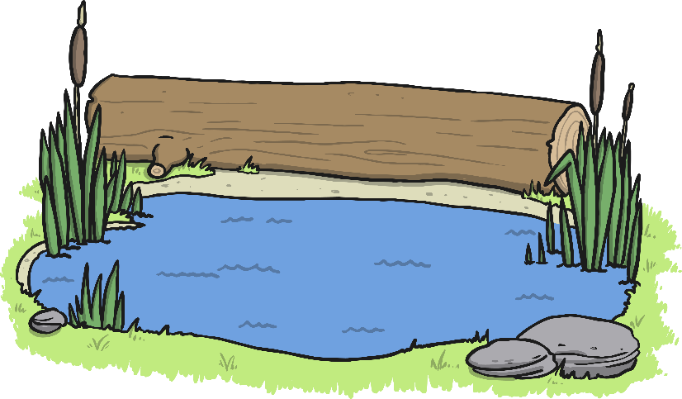
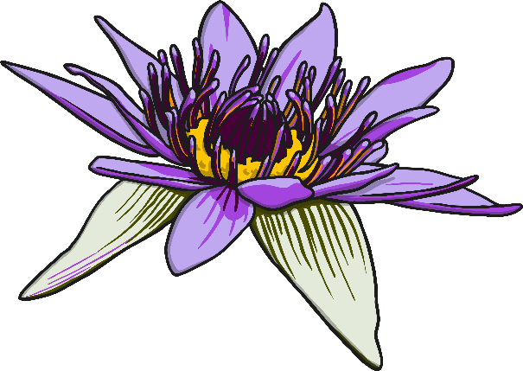
Pond Habitats
A pond is a still body of fresh water. Some ponds are man-made and appear in parks and gardens; others are natural dips and hollows in the land that have filled up with water.
Lots of plants and animals live in the water in ponds, and many more live nearby. Some plants like water lilies, hornwort and duckweed live in the water. Other plants like irises and marsh marigolds grow in the damp soil near the pond’s edge.

Slide 16
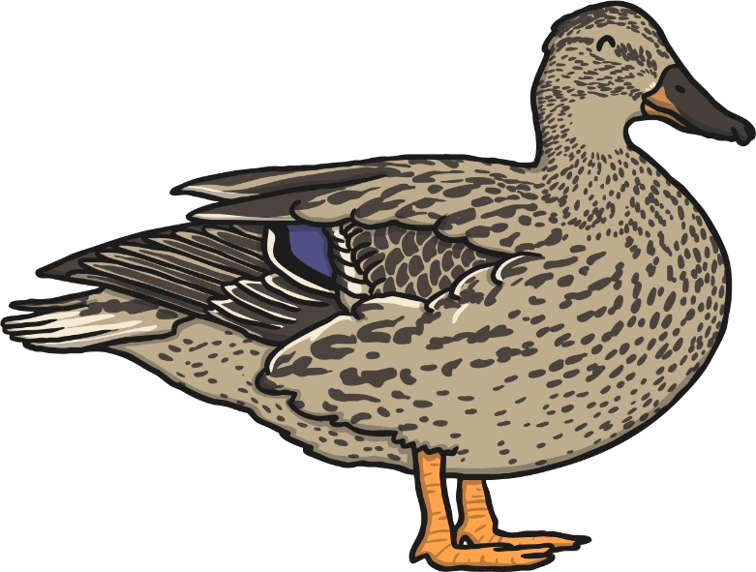
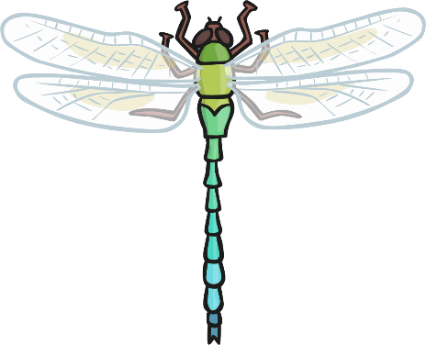
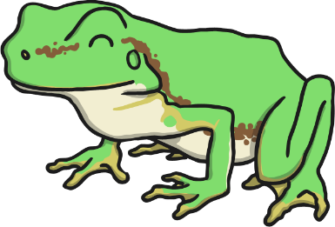
Pond Habitats
These plants provide food and shelter for worms, slugs, snails, and insects like damselflies, dragonflies, mayflies and water beetles. Amphibians like frogs, toads and newts eat the small creatures, and in turn, these are eaten by mammals like bats and water voles.
Many birds live near the water, including ducks, moorhens and kingfishers.

Slide 17
Photos courtesy of Neil Hall, Amanda Slater, Martin Pettitt and Peter Trimming (@flickr.com) - granted under creative commons licence - attribution

Slide 18
Coastal Habitats
Because Britain is made up of islands it has a lot of coastal habitats. These are places where the land meets the sea. Some of these habitats are sandy, some are marshy, and some are high, rocky cliffs.
The plants here have adapted to grow in salty, windy conditions. These include samphire, juniper, sea kale, glasswort and marram grass.
Many of the creatures that live in coastal areas survive in rock pools left by the tides, like barnacles, mussels, crabs and starfish.

Slide 19
Coastal Habitats
Wading birds such as oystercatchers, plovers and sandpipers feed on these creatures, while seabirds like seagulls, kittiwakes, gannets and skuas mainly eat fish from the sea.
Dolphins, porpoises and even whales can be seen in the waters around the coast. Seals and otters spend most of their lives in the sea but come to the land to rest and care for their babies.

Slide 20
Photos courtesy of Drew Avery, Robert Orr, Ben Salter and Michael Sveikutis (@flickr.com) - granted under creative commons licence - attribution

Slide 21
Living, Dead or Never Alive
Do you remember learning about the 7 life processes?

Slide 22
Living, Dead or Never Alive
We use the life processes to tell if something is living, dead or never alive.
If a thing is alive, it will do each of these life processes.
If the thing doesn’t do these processes, but did at some point in the past, it is dead.
If something has never done these 7 life processes, it has never been alive.

Slide 23
Living, Dead or Never Alive
What can you see that is living, dead and that has never been alive?

Slide 24
Our Local Habitat
We are going to visit a local habitat and look at it closely to see what kinds of plants, animals and non-living things are in it.
What will you see that is living, dead or has never been alive?

Slide 25
Our Local Habitat
After that, we are going to make a map of our habitat to find out what
goes where.

Slide 26
Comparing Maps
Compare your Local Habitat Maps with the other people in your group.
Do they contain the same features?
Are there any differences?
Do they contain the same living and non-living things?
If there is anything you think is missing on your map, add it now.

Slide 27
Aim
I can map a habitat and identify what is in it.
I can classify objects as those that are living, dead and those that have never been alive.
Success Criteria
I can draw a map of a local habitat.
I can draw and label the trees and plants.
I can record or suggest which animals live there.
I can sort given objects into categories and give reasons for my choice.
I can suggest my own objects to go into each of the categories.

